Slide 1

How To
Security Test ?

Slide 2

Some Basics
Do we need to be learn hacking to ensure security of the application?
Do we need to crack the application and gain access to the system to post a security issue?
Do we have any additional advantage when security testing our application?
Do we have any disadvantage security testing our application?

Slide 3
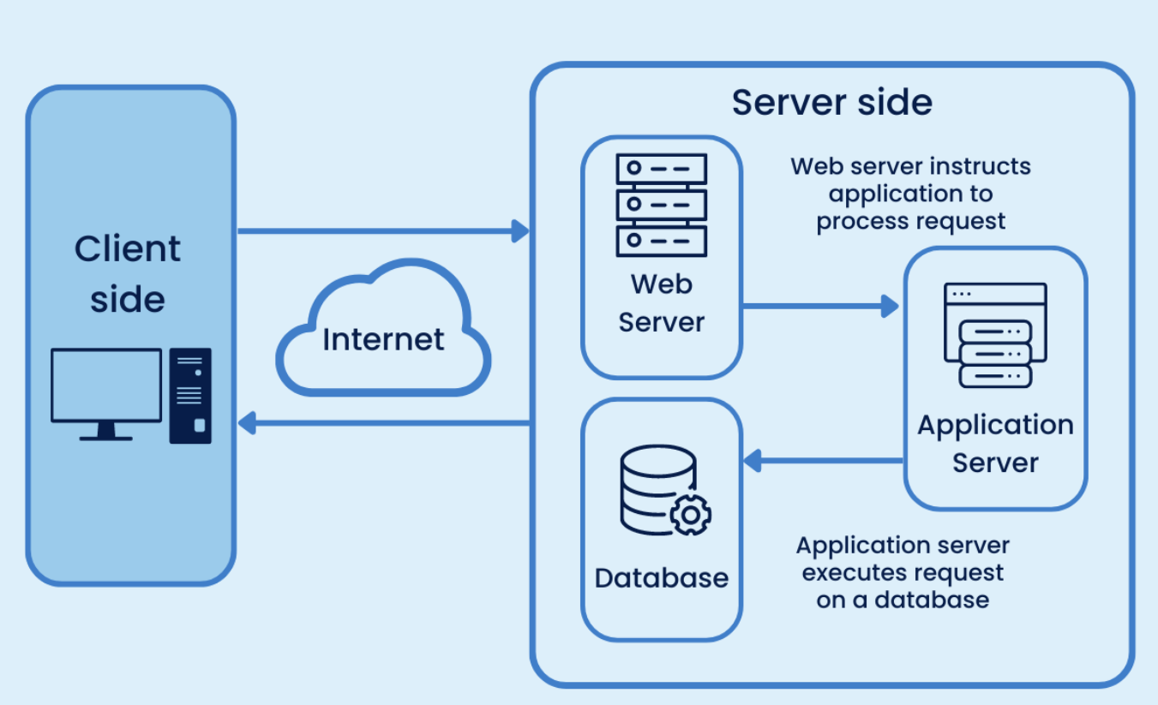
What is a website?
Item 2
Item 3

Slide 4

Most Popular Vulnerabilities
Information disclosure
Broken access control
Path Traversal
OS command injection
CSRF - Cross site request forgery
Injection vulnerabilities
XSS - cross site scripting
SSRF server side request forgery

Slide 5

Information Disclosure
When a website unintentionally reveals sensitive information to its users. This includes a part of the source code to some sensitive information such are DB passwords
Some information Seems to be not harmful. But a hacker gather so many small informations and combine them together to create an opening

Slide 6
How to test for information disclosure?
How?
Burp Intruder
Fuzz attack in ZAP
Burp Engagement tools
Discover content
Find comments
Where to attack?
URL path
URL Query parameters
POST/PUT body data

Slide 7
What to look for in the responses?
Sort the responses using response code,size etc
Sort by each and look for response code, size which is different from expected
Files for web crawlers
/robots.txt or /sitemap.xml
Directory listings
Developer comments
Error messages
Debugging data
Source code disclosure via backup files

Slide 8

Broken access control
Access control ensures that people can only gain access to things they’re supposed to have access to.
When access control is broken, an attacker can obtain unauthorized access to information or systems that can put an organization at risk of a data breach or system compromise.

Slide 9
How to test for Broken Access Control?
How?
Burp Proxy
Where?
Cookie manipulation
Accessing Private user data/privilege escalation
Insecure direct object reference

Slide 10

Path Traversal
A path traversal attack (also known as directory traversal) aims to access files and directories that are stored outside the web root folder.
By manipulating variables that reference files with “dot-dot-slash (../)” sequences and its variations or by using absolute file paths, it may be possible to access arbitrary files and directories stored on file systems including application source code or configuration and critical system files.

Slide 11
How to test for path traversal
How?
Burp interceptor/repeater
HUD in ZAP
Where?
Try to access files/paths located outside the web publish directory from urls referring files (Any files, such as sites images, downloads, exports etc)

Slide 12
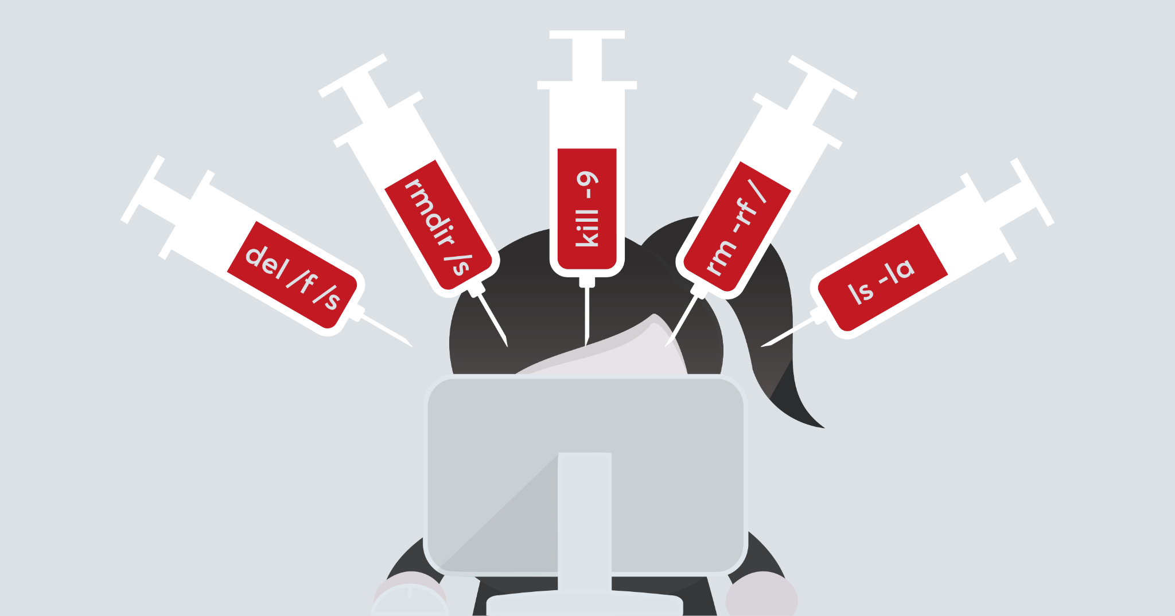
OS Command Injection
Command injection is an attack in which the goal is execution of OS commands on the host operating system via a vulnerable application.
OS command Injection is a critical vulnerability that allows attackers to gain complete control over an affected web site and the underlying web server.

Slide 13
How to test for OS Command injection
How?
Burp Intruder
Fuzz attack in ZAP
Where?
URL path
URL Query parameters
POST/PUT body data

